Slide 1
The iNotebook

Slide 2
Have you ever heard yourself say…
I can’t find my…
Notes, homework, quizzes.
I can’t remember what we did in class yesterday.
I’m sure it’s in…
my locker…
my bookbag…
my room…
I know I have that somewhere.
Where did I put…

Slide 3
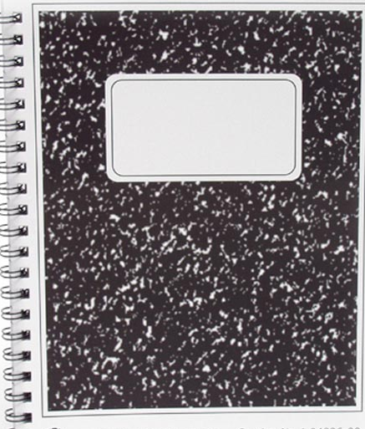
The solution to your problem has finally arrived…
The iNotebook

Slide 4
What is it?
A portfolio of your work in ONE convenient spot. It is great for studying for upcoming quizzes and tests.
A great organizational tool that gives you permission to be creative in your responses.
Allows you to be like a real scientist.

Slide 5
Scientists use notebooks

Slide 6
What will be in the iNotebook?
Bellwork
Notes
Labs
Vocabulary
Pictures/drawings
Diagrams
Foldables
Cartoons
Poems
Reflections
Quizzes/tests
Classroom activities
Personal assignments
Group work
And the list goes on, and on…

Slide 7
If we do it in here, we put it in there!

Slide 8
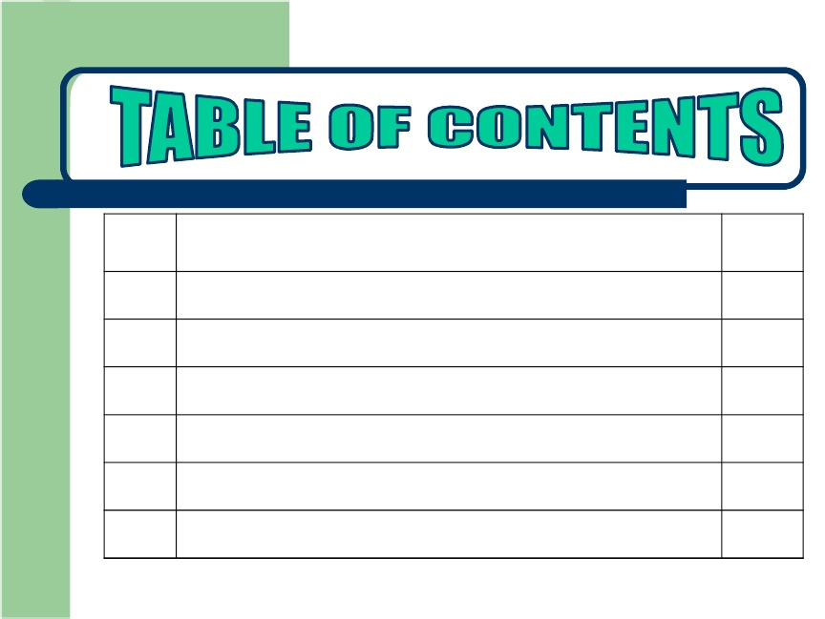
Your iNotebook will begin with a table of contents.
Date
Description
Page #
8/21/12 Science Buddies List 6

Slide 9
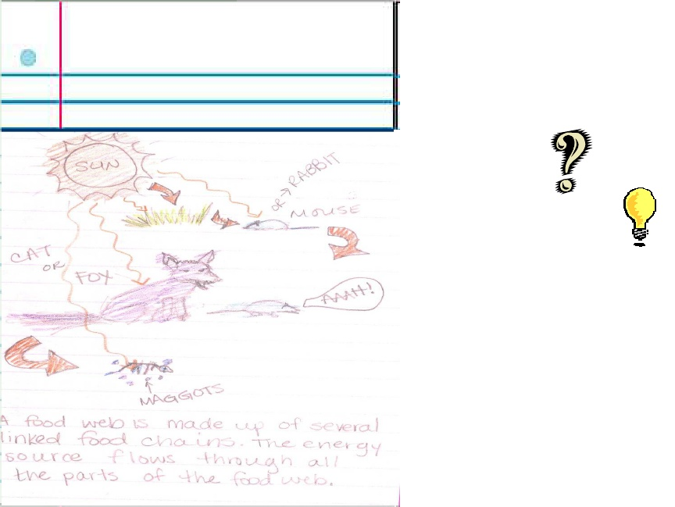
What will it look like?
_______. Lions, tigers, andbears are ________. Worms andmushrooms are_________
Who is your favorite scientist?
My favorite scientist is Thomas Edison because he invented the lightbulb and without it we would not be where we are today.
Every day will begin with a bellwork question/activity. This will be put at the top of the required page. The question must be copied and the answer written in a complete sentence .

Slide 10
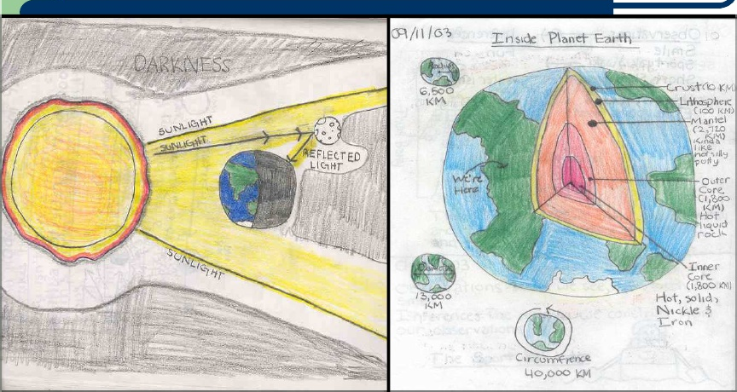
Drawings and illustrations

Slide 11
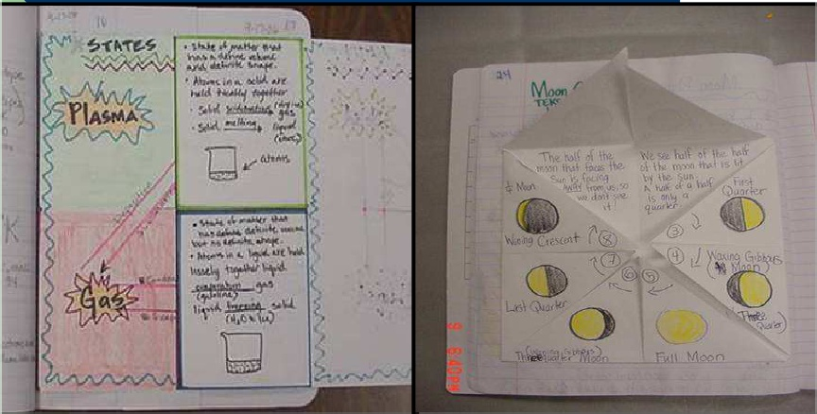
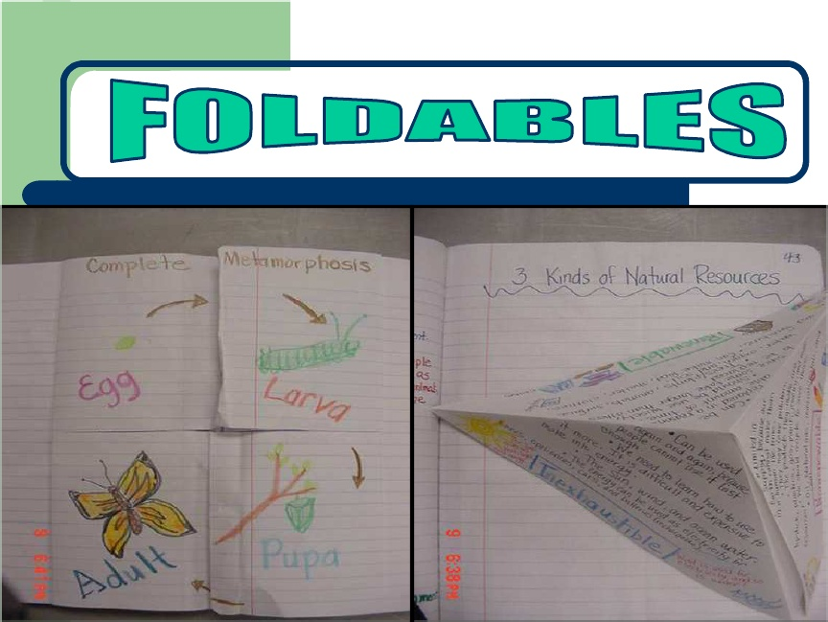
Foldables

Slide 12
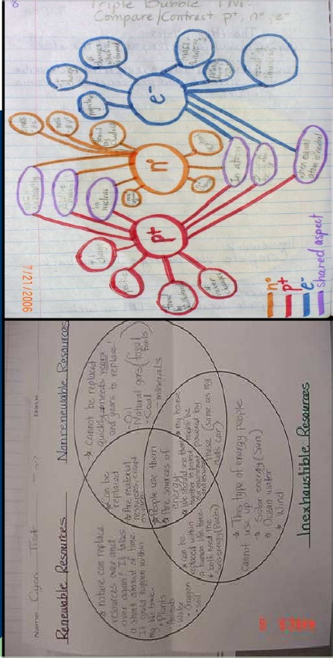
Graphic Organizers

Slide 13
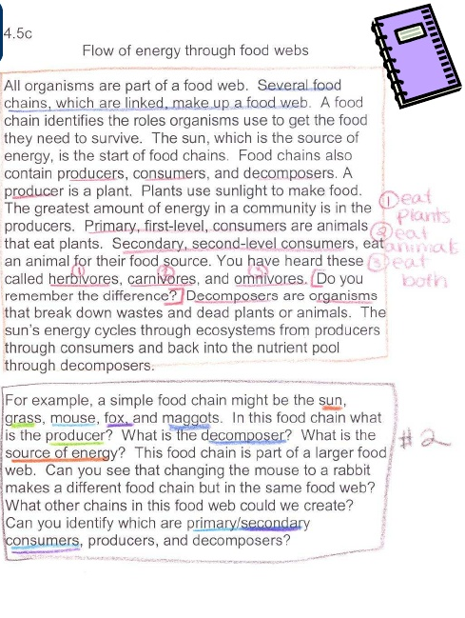
Notes
All classroom notes will be included in your iNotebook.

Slide 14
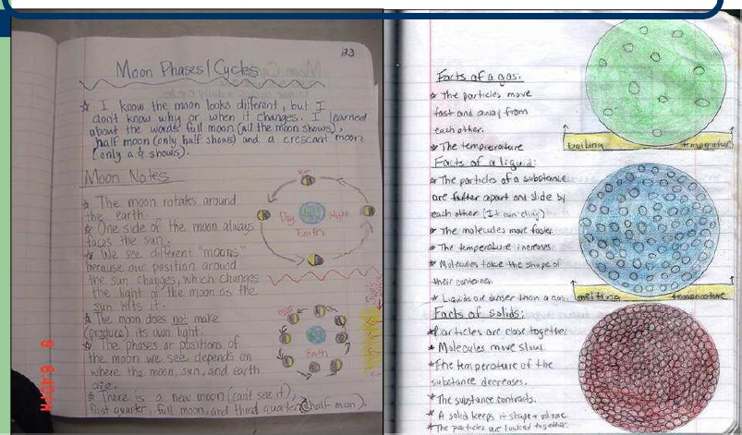
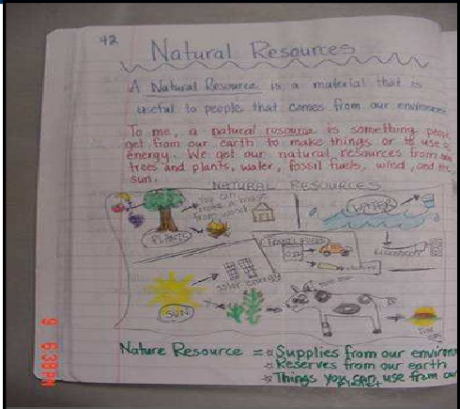
Notes Continued

Slide 15
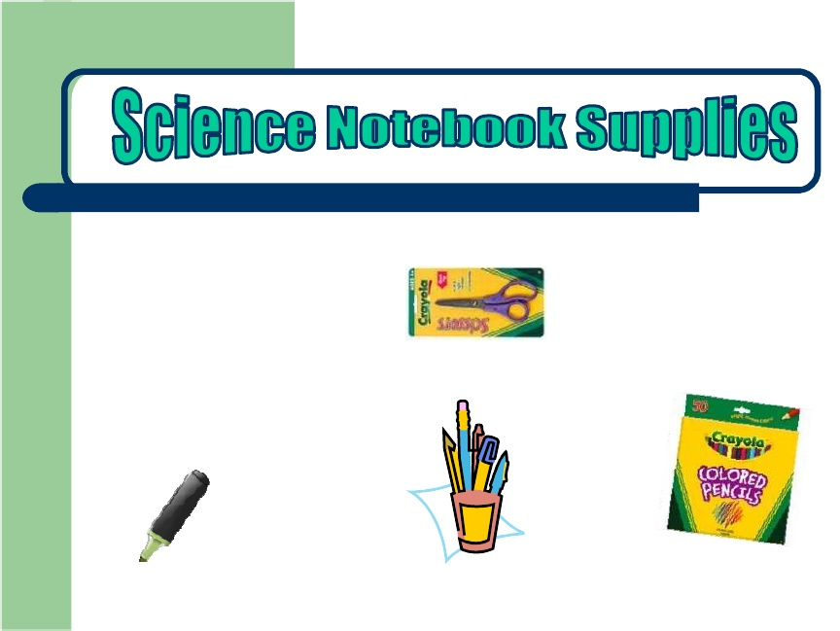
iNotebook Supplies
Scissors
Glue
Spiral Notebook
Colored Pencils/Crayons
Highlighters
Pencils/Pens
No Markers!

Slide 16
Getting Started:
Numero Uno (1)
Front Cover
  You may design the cover but you must include the following:
Your Name
Name of the course (Mrs. Kelling Science)
Class Period
School Year

Slide 17
Getting Started:
Numero Dos (2)
Classroom Expectations and Consequences on back of front cover
Classroom Expectations
1.
2.
3.
Classroom Consequences
1.
2.
3.

Slide 18
Getting Started:
Numero Tres(3)
Table of Contents
Date | Description | Page Number
8/21 | iNotebook Rubric | 1
8/21 | Science Buddies Sheet

